Slide 1
The contest will resume at
10:35 am

Slide 2
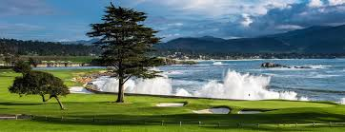
Area A1/A2/A3 Contests March 20, 10:00 am to 12:30 pm Register: https://bit.ly/2021-AreaA123

Slide 3
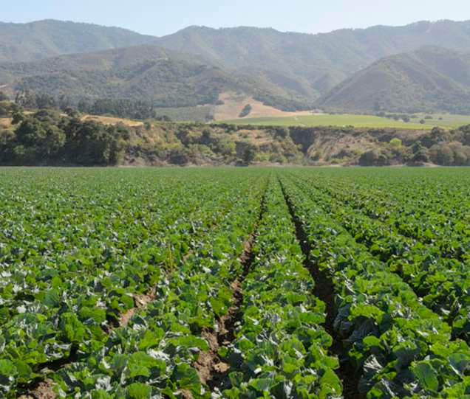
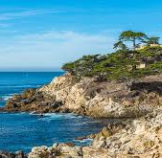
Division A Speech Contests April 3, 10:00 am to 12:30 pm Register: https://bit.ly/2021-DivA

Slide 4
District 101 Conference
May 15–16, 2021
Details coming soon…

Slide 5
Membership Renewal Challenges!

Slide 6
District 101
Open House Challenge

