Slide 1
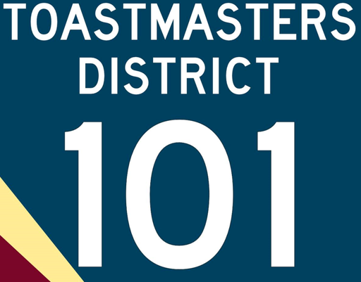
Yearning for
Proficient Communication?
Increased
Confidence?
We have both…
Join <club name> for an Open House!
Do you want to improve your communication skills? Or perhaps sharpen your thinking and listening skills? Then join <Club> for an Open House to learn more about it!
Aug 16th, Wednesday
6:00 pm - 9:15 pm
<address>
An Open House is a good chance to:
Get to know more about Toastmasters. There will be Q&A if you have questions
Signup/Renew for Membership
<Free Food>

